Slide 1
Start coding instantly
Rodrigo Moreirao – Cloud solution architect
Dennis van de Laar – Digital & Application innovation specialist
Notes:
Welcome
Intro Dennis en Rodrigo

Slide 2


DevOps is key to enabling agile development of modern apps
Higher revenue growth for organizations that have widely adopted DevOps1
1 McKinsey Developer Velocity Research, 2020
Notes:
Slide title: DevOps is key to enabling agile development of modern apps
What we all have seen the last years, is that:
Across industries, modern development processes have transformed what developers can achieve.
Best-in-class planning, development, security and collaboration tools make it easier for developers to innovate and accelerate time-to-value for the business
The maturity of the DevOps adoption differs per organization and per industry
Empowering developers means tangible business value as well—according to McKinsey, organizations with widely adopted DevOps practices see four-times higher revenue growth than their counterparts.

Slide 3

Current infrastructure remains a bottleneck to agility by limiting productivity and security
Complex setup
Security of remote devices
Onboarding new developers is error-prone and time-consuming, and if configured incorrectly, issues take weeks to emerge
Remote developer teams working on a variety of devices make it harder for IT technicians to control access to sensitive source code
Inefficient environments
Increased risk of exposure
!
Mixing configurations from a variety of projects slows down workstations and can result in issues that are hard to diagnose
IT technicians can’t manage the uptime of dev workstations running remotely, putting them at greater risk of exposure
Lack of compute scalability
Varying industry standards
Developers working on single, physical machines are limited to that device’s compute resources and can’t easily multitask between projects
Compliance standards differ across industries, requiring a variety of approaches to the deployment and management of dev workstations
Notes:
Slide title: Current infrastructure remains a bottleneck to agility by limiting productivity and security
Yet for all the good that modern dev tools and practices already provide, many developers are still constrained by their existing software engineering systems.
Setup: When onboarding to a new project for instance, devs must work with the dev infra team to set up and configure their workstation. This can take days—if not weeks—to complete and is prone to errors that take even longer to emerge and address.
Multi projects: For developers working across projects, trying to manage too many dependencies on a single workstation can result in even more errors and conflicts that bog down the system. Paired with static compute resources, this can make it hard for developers to quickly switch between tasks and perform high-demand processes.
Security: At the same time, modern dev workstations also pose several security risks for the organization—particularly when expanding to hybrid dev teams with members spread around the world. As remote work becomes more common, it’s harder than ever for IT admins to control access to sensitive information like source code. IT admins also can’t manage remote workstations in the same way as on-prem workstations, putting developers and their devices at increased risk of exposure. This is especially problematic when trying to support developers working across a variety of industries, as many industries come with their own set of regulatory requirements that are hard to enforce on remote devices.

Slide 4
New infrastructure solutions can help bridge the gap between dev and infra teams by enabling…
Speed
Governance
Usability
Provide developers with ready to code, fast, self-service access to the infrastructure they need
Maintain centralized control over security, compliance, and cost management
Provide all the tools, services, and resources needed by developers
Notes:
Slide title: New infrastructure solutions can help bridge the gap between dev and infra teams by enabling…
To overcome these challenges, a new approach to software development infrastructure is needed—one that empowers developers and IT admins alike.
For developers, speed and usability are critical—ensuring they have convenient, self-service access to all the tools and resources they need to focus on their code without interruption. At the same time, effectively managing security, compliance, and cost requires centralized controls in the hands of IT admins and dev infrastructure teams.
At Microsoft, we’re working to empower developers to realize their full potential and are committed to reducing barriers to productivity and agility.

Slide 5
Microsoft
GitHub
Dev Box
Codespaces
Notes:
Slide title: DevOps is key to enabling agile development of modern apps
Across industries, modern development processes have transformed what developers can achieve. Best-in-class planning, development, and collaboration tools make it easier for developers to innovate and connect with their dev teams, while automated processes help improve performance. In doing so, these tools and processes empower devs to focus on the creativity of development while writing the code that only they can write.
Empowering developers means tangible business value as well—according to McKinsey, organizations with widely adopted DevOps practices see four-times higher revenue growth than their counterparts.

Slide 6
Todays cloud box segmentation
Customer subscription
Hosted on behalf of customer
Generic
workload
Azure Virtual Desktop
Windows 365
Cloud PC
Flexibility single/multi session
Virtualized desktop & Apps
Simple, Easy setup and IT management, SLA’s
Virtualized persistent desktop
Developer
workload
Azure DevTestLabs
Codespaces
Dev Box
Configurable, cost controlled
Virtualized desktop
Instant-on,
Configurable,
Repo centric,
virtualized IDE
Custom,
Pre-configured,
Powerful,
virtualized Desktop
Notes:
Azure DTL = PaaS solution
Microsoft DevBox = SaaS solution / Consumption based
W365 Cloud PC = License based

Slide 7
Microsoft Dev Box
Notes:
Slide title: Introducing Microsoft Dev Box
That’s why we’re excited to announce Microsoft Dev Box, ready-to-code, secure developer workstations for a hybrid team of any size.

Slide 8





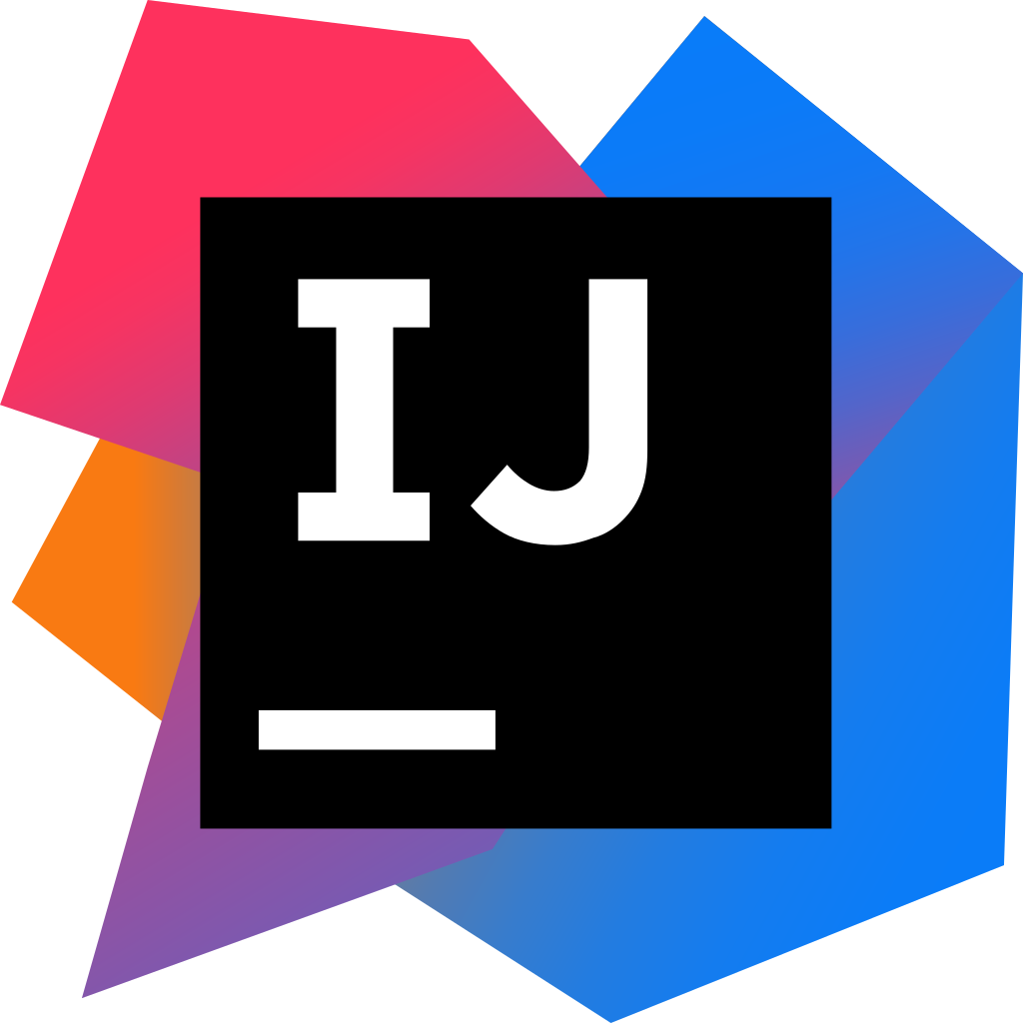


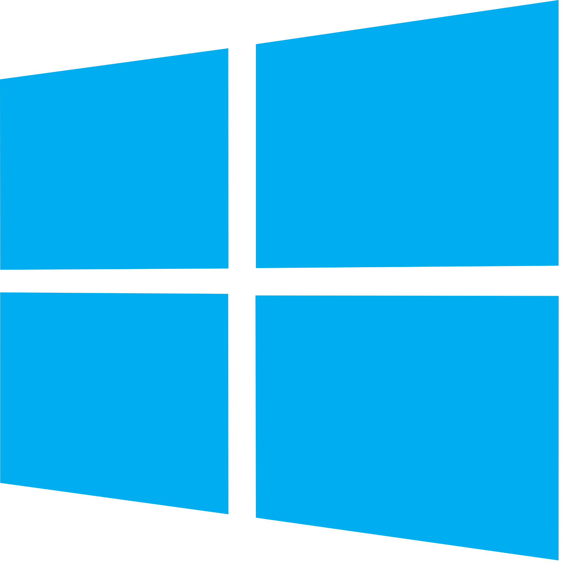


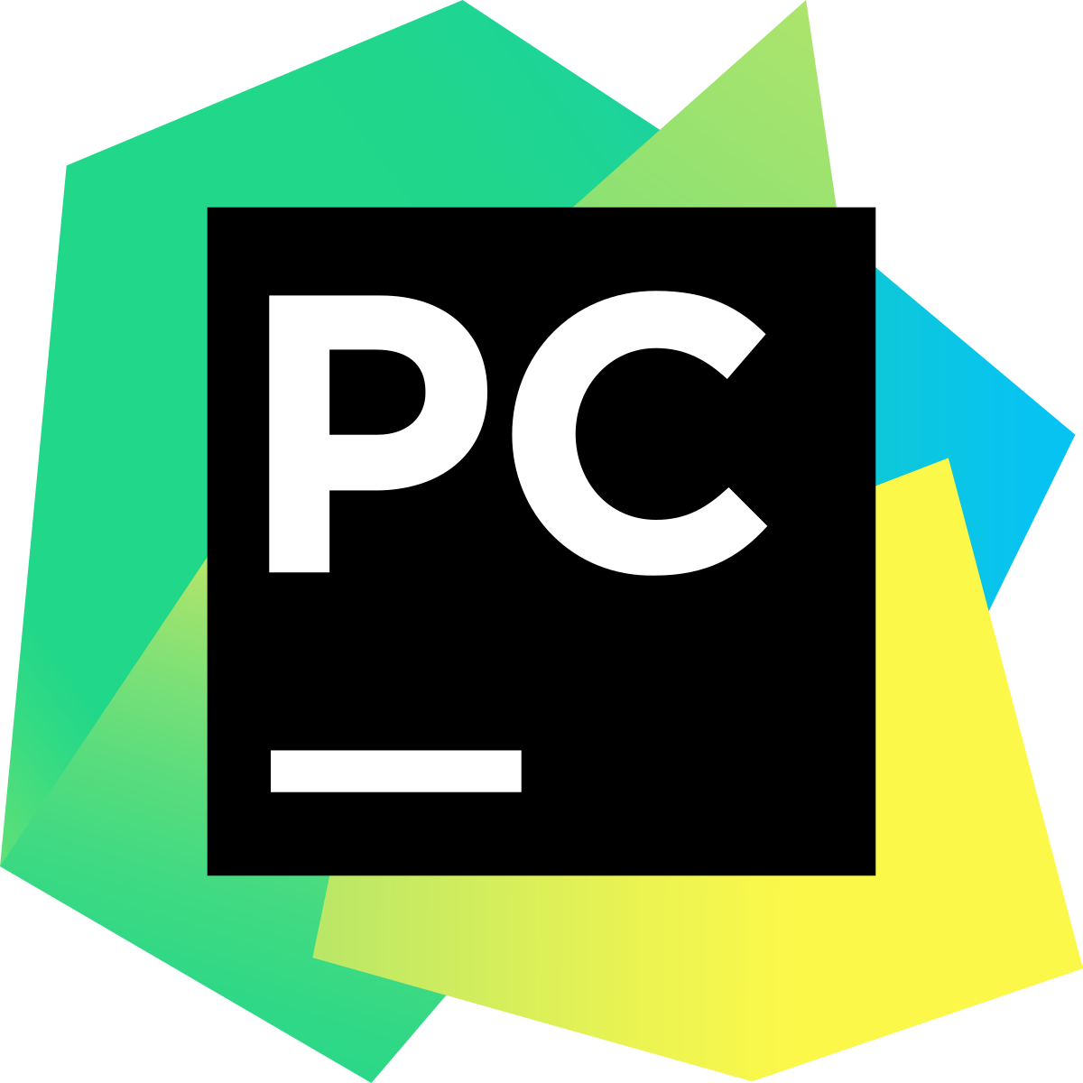

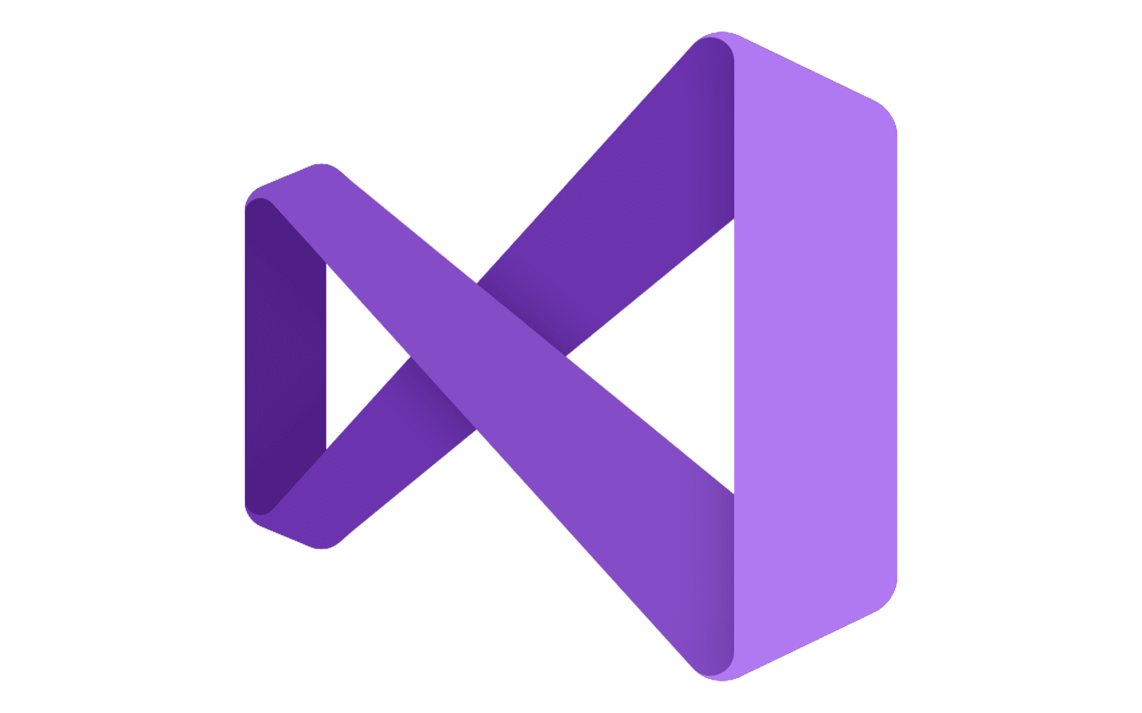
Enable self-service development with Microsoft Dev Box
Provide developers with self-service access to high-performance, cloud-based workstations preconfigured and ready-to-code for specific projects
Ready to code
Flexible but controlled
Managed and secure
Maximize dev productivity with ready-to-code, self-service workstations preconfigured for specific projects and tasks
Customize workstations with everything developers need for their current projects while adhering to organizational standards
Centralize governance of workstations running anywhere to maintain greater security, compliance, and cost efficiency
Provision any workload
Build any app using any dev tool and repo
Notes:
Slide title: Enable self-service development with Microsoft Dev Box
Microsoft Dev Box provides developers with self-service access to high-performance, cloud-based workstations preconfigured and ready-to-code for specific projects and tasks.
Dev Boxes are ready-to-code, enabling developers to get started quickly without having to worry about setting up and configuring their workstation. Developers can simply select from a pool of preconfigured Dev Boxes provided by their dev team and run and understand their code as soon as the Dev Box deploys.
At the same time, Dev Boxes are managed and secured through centralized governance tools operated by IT. Wherever Dev Boxes are running, IT admins and dev infra teams can track and monitor their usage to ensure greater security, compliance, and cost efficiency.
To ensure Dev Boxes can support any developer workload without exposing the organization to unnecessary risk, they are flexible but controlled—dev teams preconfigure Dev Boxes for their developers, including whatever dev tools, SDKs, code repos, and more that their developers need for any project or specific task.
Now, let’s take a deeper look at the benefits Dev Boxes provide your dev and IT teams.

Slide 9
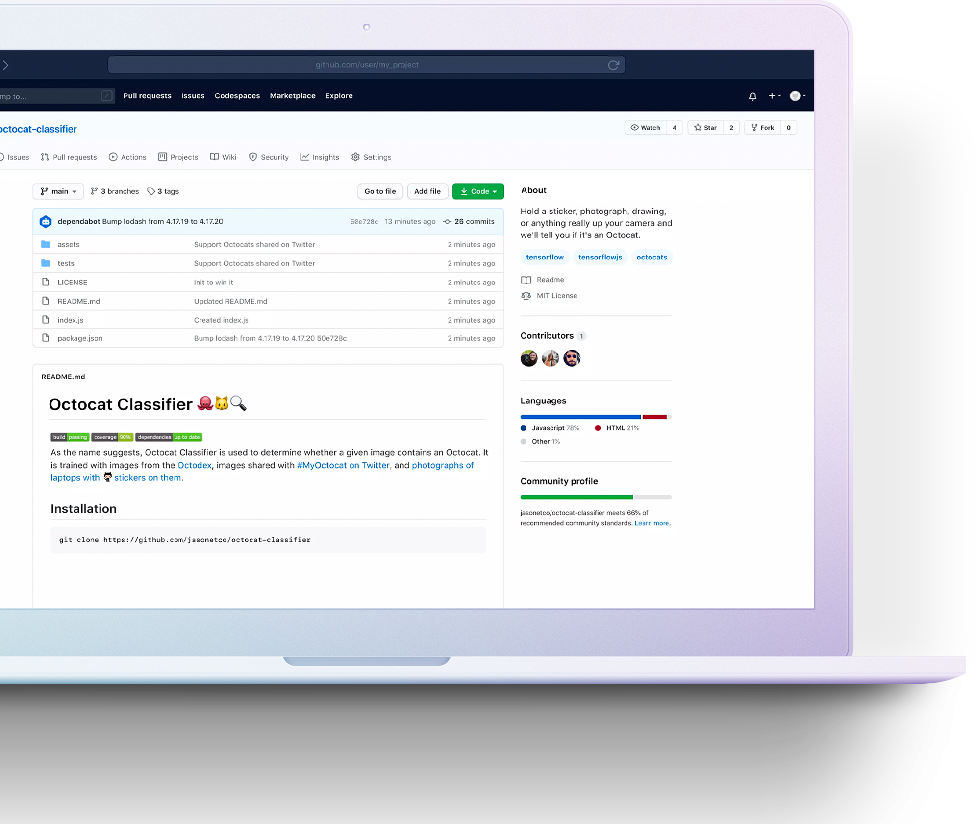
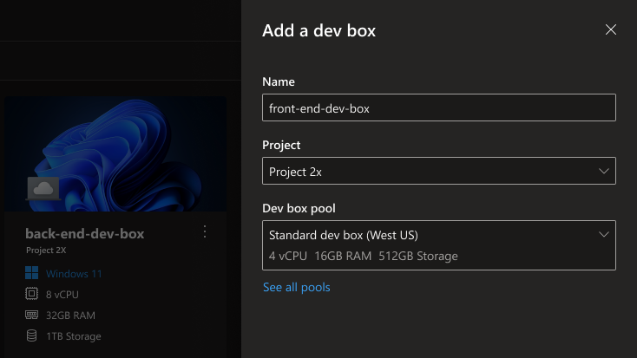
Ready to code
Support developers with self-service, on-demand dev boxes
Streamline developer onboarding with preconfigured Dev Boxes that accelerate deployment and provisioning
Empower developers to code on demand and quickly switch between projects with task-based, self-service dev boxes
Provide developers with a custom library of ready-to-code, project-specific dev box pools
Notes:
Slide title: Ready to code
Dev Boxes make it easy for developers to get started quickly by providing them with self-service access to workstations purpose-built for their current projects and tasks.
With Dev Boxes, developers can onboard quickly without having to work directly with dev infra teams by leveraging preconfigured Dev Boxes that are ready-to-code upon deployment.
Developers can deploy multiple Dev Boxes at the same time, making it easy to switch between projects without bogging down their machine. Developers can simply deploy the right Dev Box to support their current task.
Dev teams can set up pools of Dev Boxes for their developer’s different projects, ensuring devs can always access a Dev Box that will suit their needs without having to wait for help from dev infra teams to build out a new environment.
So how exactly do dev teams build Dev Boxes to support their developers?

Slide 10
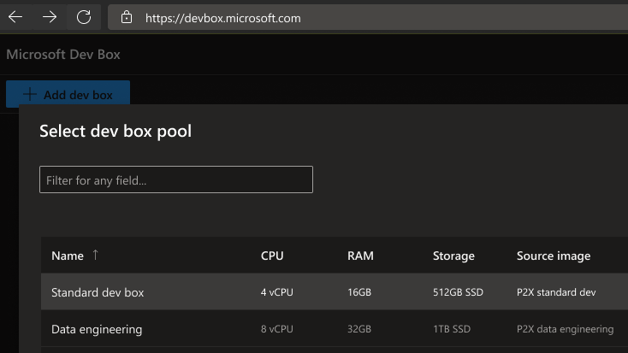
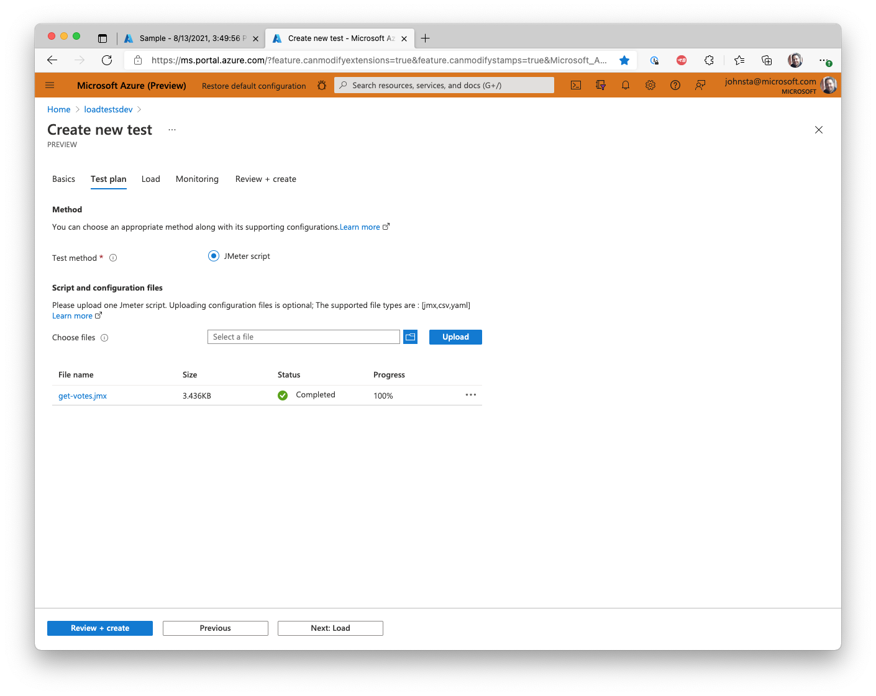

Flexible workloads
Quickly set up developers for virtually any development workload
Configure project-specific, task-based dev boxes with the right dev tools and code repos to support any workload
Create role-based dev boxes to support everyone on the team—from site reliability engineers to contractors
Keep costs under control with stop scheduling and a consumption-based pricing model
Notes:
Slide title: Flexible workloads
While Dev Boxes are a controlled, standardized resource for developers, they are highly customizable and flexible behind the scenes, enabling dev teams to configure Dev Boxes to support any dev workflow.
Dev Boxes support any dev tool, code repo, SDK, and more that developers may need for their project or task, meaning they can be used for any dev workflow—whether desktop or mobile development, gaming, or IoT. Dev Boxes can even be used for cross-platform development thanks to WLS support. Dev box SKUs support high-demand workloads meaning you can preconfigure dev boxes with the right amount of compute, RAM, and storage to support even the most demanding workflows.
To support every developer on the team, dev teams can assign Dev Boxes based on Azure Active Directory groups, making it possible to limit control and access for certain roles while giving greater permissions to others. For instance, if you need to establish a secure environment for a site reliability engineer, you can setup a Dev Box as a privileged access workstation. Conversely, on large projects where parts of the work are outsourced, you can apply stricter permissions for external contractors.
To keep costs under control, dev teams can set automated stop scheduling so that dev boxes shut down at night when not in use. Dev Box uses a consumption-based pricing model that charges for the amount of storage and compute used, meaning you only pay for what you use.

Slide 11
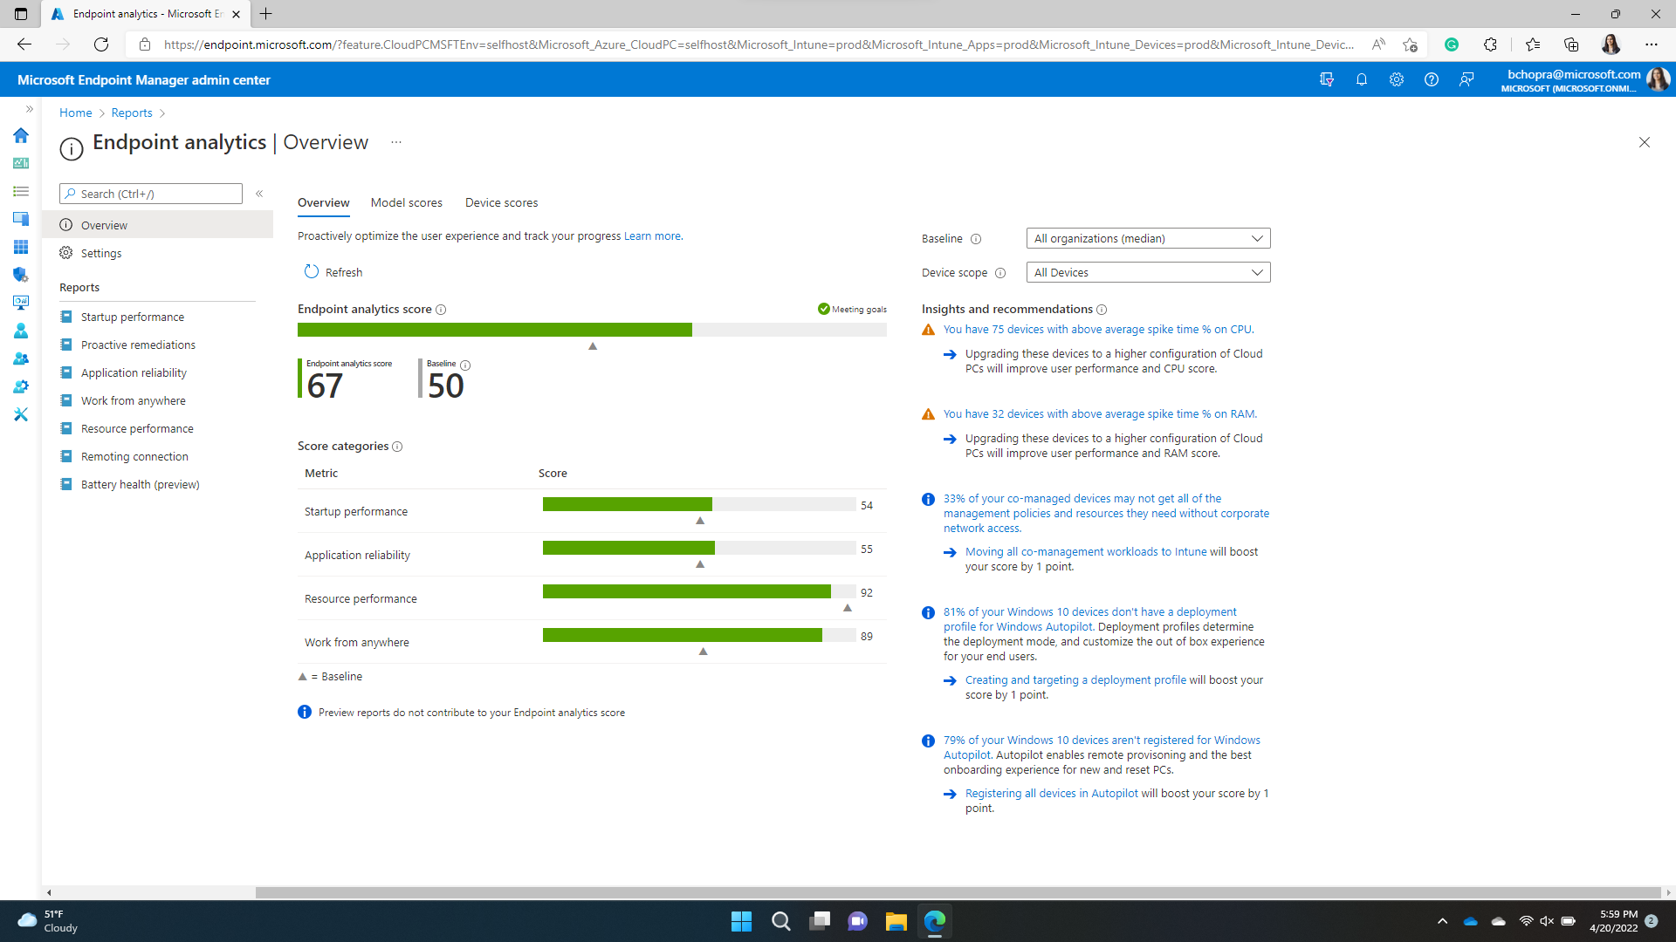
Managed and secure
Maintain greater control over security, compliance, and cost
Integrate with existing enterprise infrastructure management systems to extend policies across remote devices
Control cloud resource configurations on a project-by-project basis by enforcing Azure policies for each dev box
Keep dev boxes up to date by applying zero-day patches to devices running across the organization
Notes:
Slide title: Managed and secure
But Dev Boxes don’t just empower dev teams—they offer critical tools to IT and dev infra professionals as well, making it easy to maintain greater control over security, compliance, and cost.
Microsoft Dev Boxes are automatically enrolled in Intune and managed by Microsoft Endpoint Manager, making it easy for IT admins to manage Dev Boxes like any other device.
Comprehensive access controls in AAD enable IT admins to organize access by project or user type, making it easy to control permissions and policies on a project-by-project and Dev Box-by-Dev Box basis. For especially sensitive workloads, for instance, you can set conditional access policies or risk-based sign-in policies, such as requiring users to connect via a compliant device or requiring MFA sign-in.
Thanks to Intune integrations, IT admins can easily push out zero-day patches to whatever devices they need to update across the organizations, ensuring all Dev Boxes are kept up-to-date. Should a Dev Box ever become compromised, IT admins can isolate the Dev Box while helping the developer get up and running on a new Dev Box.

Slide 12
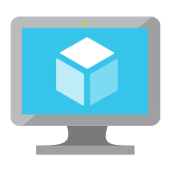


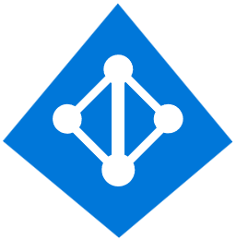
High level overview – Microsoft Dev Box
1. Create dev box components
2. Preconfigure dev box pools
3. Manage dev boxes running anywhere
Dev center
Project 1
Microsoft Endpoint Manager
Dev box pool 1
Run reports:
Endpoint analytics:
Remoting connection
86
50
+
Start-up performance
Network connections
Dev box definitions
Network connection
Dev box definition
Resource performance
Score
Baseline
Dev box 1: high-compute workspace
Azure region
Dev box SKU
(compute, storage)
Dev box pool 2
Dev box 2: data engineer workspace
vNet connection
+
Domain join type
Azure Marketplace or custom image
Conditional access policies:
MFA login
Secure access
Compliant device
Network connection
Dev box definition
Project 1
Dev box pool 3
Cloud PC 1: marketing workspace
Project 2
+
Cloud PC 2: finance workspace
Project 3
Network connection
Dev box definition
On-prem laptop: On-site user
…
Create network configurations and dev box definitions for use across projects, and assign dev leads as project admins.
Create dev box pools that combine a network configuration and dev box definition, and assign users from AAD Users and Groups.
Enable self-service deployment of dev boxes while monitoring and managing security, compliance, and device health from Microsoft Endpoint Manager.
Notes:
Slide title: Managed and secure
But Dev Boxes don’t just empower dev teams—they offer critical tools to IT and dev infra professionals as well, making it easy to maintain greater control over security, compliance, and cost.
Microsoft Dev Boxes are automatically enrolled in Intune and managed by Microsoft Endpoint Manager, making it easy for IT admins to manage Dev Boxes like any other device.
Comprehensive access controls in AAD enable IT admins to organize access by project or user type, making it easy to control permissions and policies on a project-by-project and Dev Box-by-Dev Box basis. For especially sensitive workloads, for instance, you can set conditional access policies or risk-based sign-in policies, such as requiring users to connect via a compliant device or requiring MFA sign-in.
Thanks to Intune integrations, IT admins can easily push out zero-day patches to whatever devices they need to update across the organizations, ensuring all Dev Boxes are kept up-to-date. Should a Dev Box ever become compromised, IT admins can isolate the Dev Box while helping the developer get up and running on a new Dev Box.

Slide 13

High level overview – Microsoft Dev Box
Microsoft Dev Box
Windows 365
Azure Resource Manager
API
Capabilities
Capabilities
Self-service Provisioning
Billing
Provisioning
HA / DR
Resource Provider
Schedules
Cost Control
Device enrollment
Capacity Mgmt
Azure Portal
Automatic Image Update
Access Mgmt
Network Tests
Image Validation
Data plane
MSI
vNet Injection
Microsoft Subscriptions (HoBo)
Dev portal
IT / Dev Infra Teams
Dev Box 1: Preconfigured as high-compute workspace
Azure Compute
Gallery
Dev Box 2: Preconfigured as mobile app project
Azure Virtual Desktop
Developer
RD Gateway
RD Web
RD Broker
Azure Active
Directory
Azure AD or Hybrid AD Joined
Notes:
Slide title: Managed and secure
But Dev Boxes don’t just empower dev teams—they offer critical tools to IT and dev infra professionals as well, making it easy to maintain greater control over security, compliance, and cost.
Microsoft Dev Boxes are automatically enrolled in Intune and managed by Microsoft Endpoint Manager, making it easy for IT admins to manage Dev Boxes like any other device.
Comprehensive access controls in AAD enable IT admins to organize access by project or user type, making it easy to control permissions and policies on a project-by-project and Dev Box-by-Dev Box basis. For especially sensitive workloads, for instance, you can set conditional access policies or risk-based sign-in policies, such as requiring users to connect via a compliant device or requiring MFA sign-in.
Thanks to Intune integrations, IT admins can easily push out zero-day patches to whatever devices they need to update across the organizations, ensuring all Dev Boxes are kept up-to-date. Should a Dev Box ever become compromised, IT admins can isolate the Dev Box while helping the developer get up and running on a new Dev Box.

Slide 14
GitHub codespaces
Notes:
Slide title: Introducing Microsoft Dev Box
That’s why we’re excited to announce Microsoft Dev Box, ready-to-code, secure developer workstations for a hybrid team of any size.

Slide 15
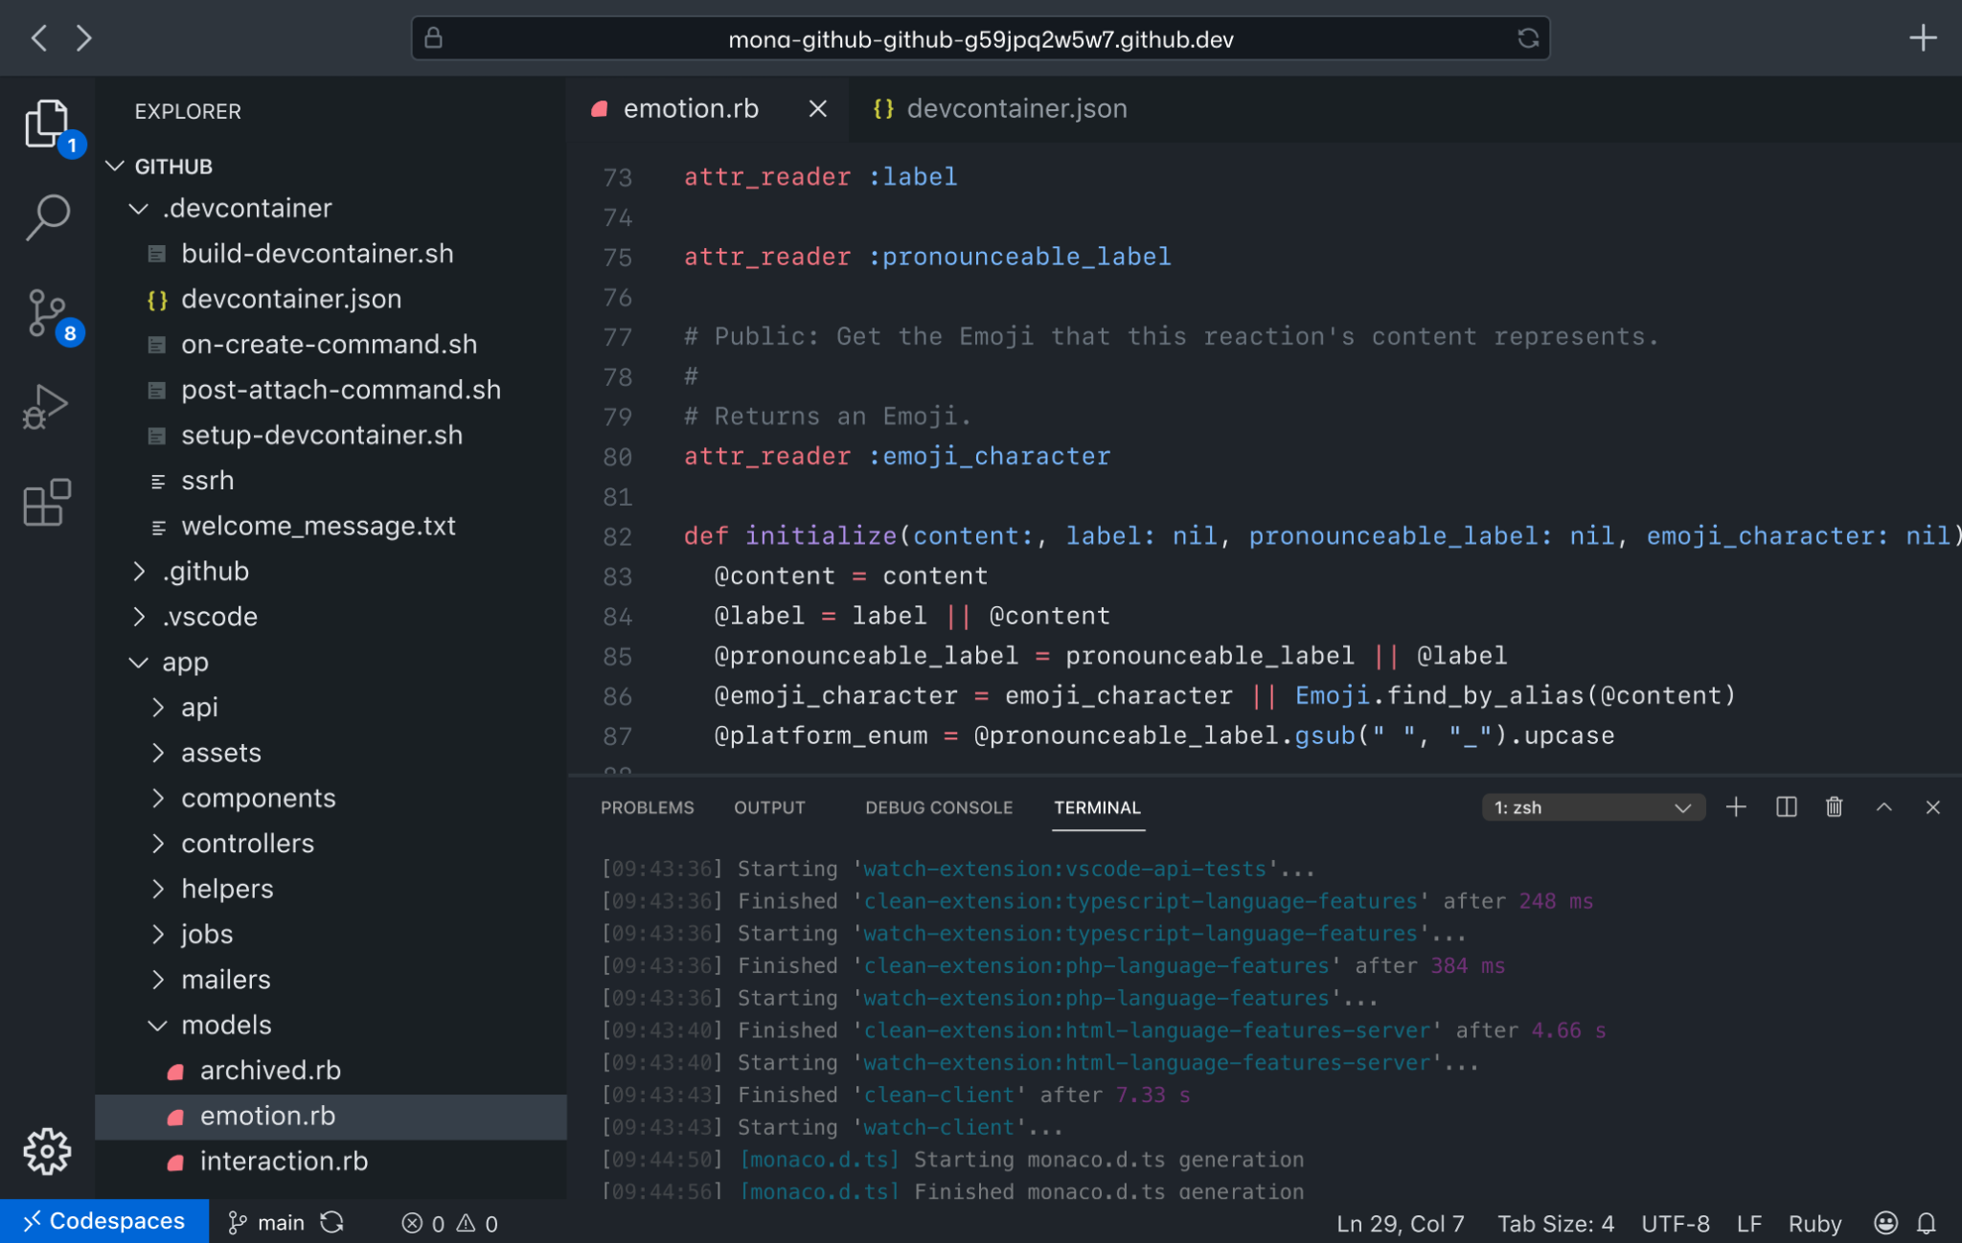
GitHub Codespaces
Blazing fast cloud developer environments
Full compute backing, up to 32 cores and 64 GB RAM

Slide 16

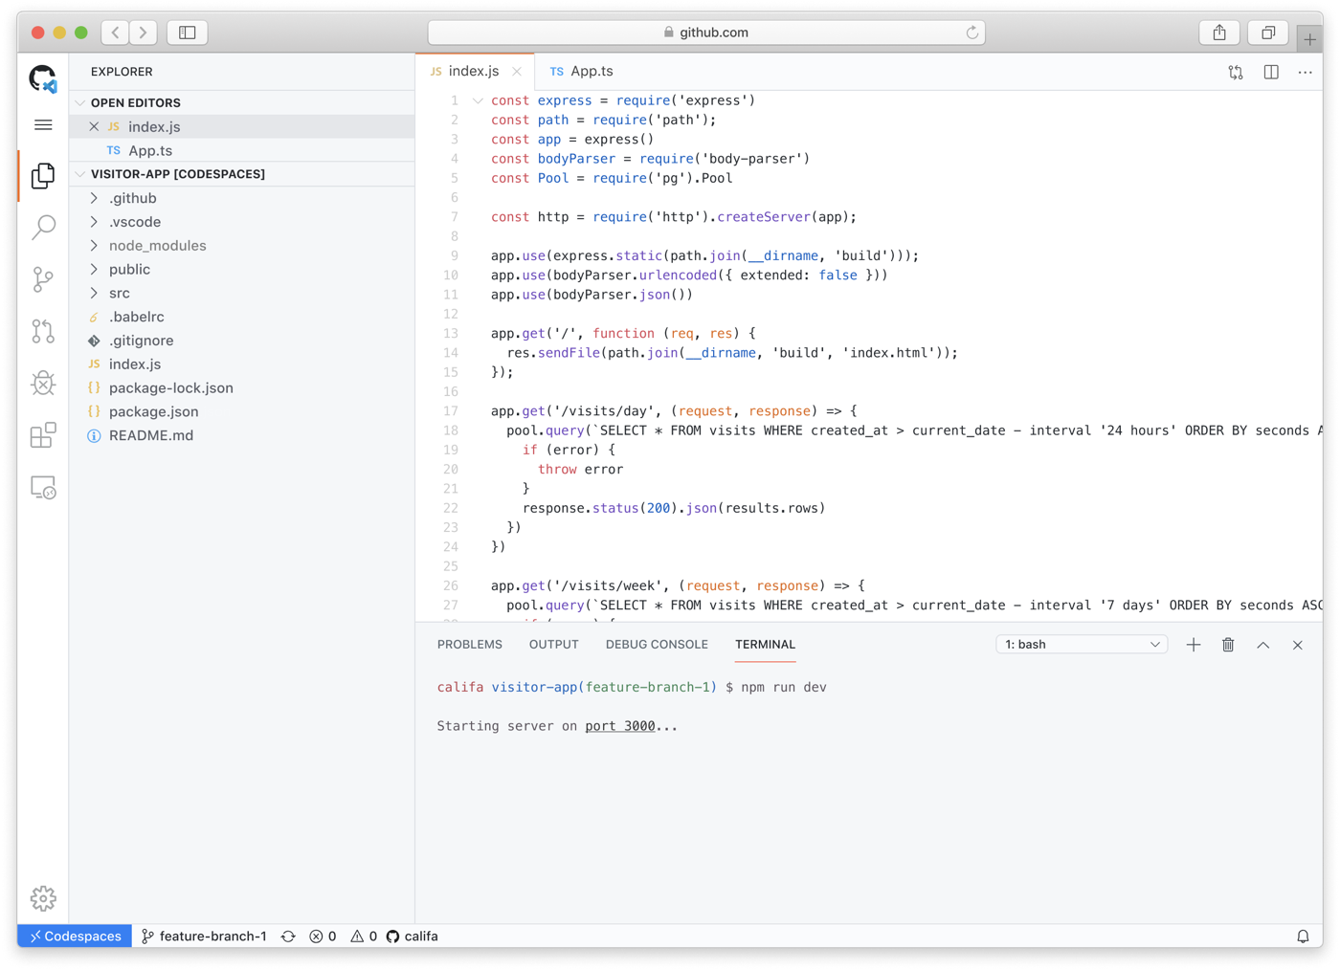



Codespaces
A cloud dev environment that lets you code from anywhere
Code without compromise
Code, build, test, debug, and deploy with a complete development environment in your browser, running on Azure.
Simplify your workflow
Automatically set up dependencies and SSH keys. Go from code to commit faster on any project.
Extend and customize
Configure your editor with dotfiles and VS Code extensions to create a consistent environment in every Codespace.

Slide 17
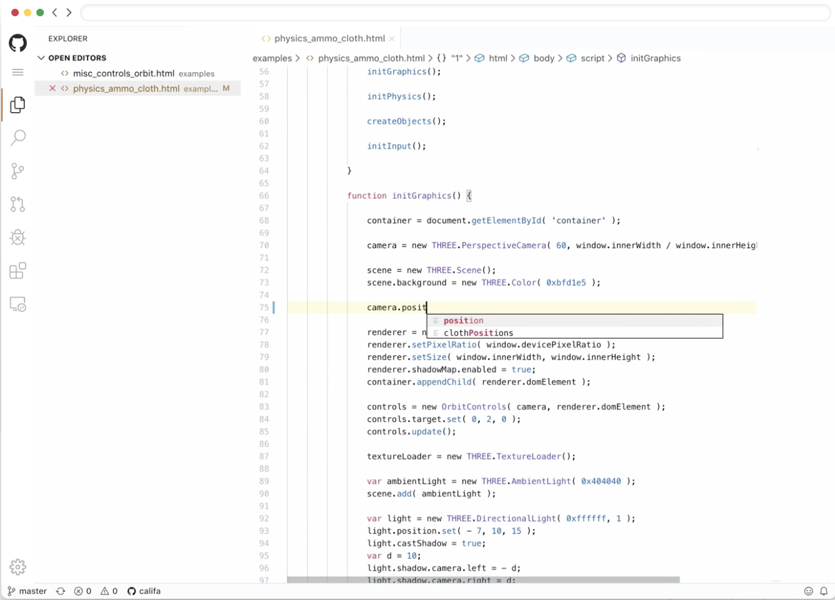
What is Codespaces?
Editor Browser, VS Code, Visual Studio
Azure Containers run services in the cloud
Container
Container
Container

Slide 18
What is Codespaces?
Run a codespace from any device just by logging into your GitHub account
Open your latest work instantly from work, home or anywhere else
Codespaces uses VS Code and Visual Studio 2019, two of the most popular and well-loved developer environments
Configure with dependencies pre-installed, so you don’t have to worry about installing just the right environment to comment, review, or contribute

Slide 19






Complimentary services
GitHub
Microsoft
Codespaces
Dev Box
Operating system
Linux
Windows
Repos on GitHub
SCM Support
Any version control system
Cloud native apps
Including: web apps, APIs, backends
Any workload
Including: Desktop, IoT, mobile, games, & more (Windows or cross-plat)
Target workloads
IT Mgmt.
GitHub.com
Endpoint Manager
Microsoft
Azure
Notes:
Slide title: Managed and secure
But Dev Boxes don’t just empower dev teams—they offer critical tools to IT and dev infra professionals as well, making it easy to maintain greater control over security, compliance, and cost.
Microsoft Dev Boxes are automatically enrolled in Intune and managed by Microsoft Endpoint Manager, making it easy for IT admins to manage Dev Boxes like any other device.
Comprehensive access controls in AAD enable IT admins to organize access by project or user type, making it easy to control permissions and policies on a project-by-project and Dev Box-by-Dev Box basis. For especially sensitive workloads, for instance, you can set conditional access policies or risk-based sign-in policies, such as requiring users to connect via a compliant device or requiring MFA sign-in.
Thanks to Intune integrations, IT admins can easily push out zero-day patches to whatever devices they need to update across the organizations, ensuring all Dev Boxes are kept up-to-date. Should a Dev Box ever become compromised, IT admins can isolate the Dev Box while helping the developer get up and running on a new Dev Box.

Slide 20



Demo
1. Build sample app in Dev Box environment
Dev center
Network connections
Dev box definitions
Project 1
Dev box pool 1
2. Configure Dev center & projects
+
Network connection
Dev box definition
Dev box pool 2
+
Network connection
Dev box definition
3. Start developing in dev container on codespaces
Notes:
Slide title: Managed and secure
But Dev Boxes don’t just empower dev teams—they offer critical tools to IT and dev infra professionals as well, making it easy to maintain greater control over security, compliance, and cost.
Microsoft Dev Boxes are automatically enrolled in Intune and managed by Microsoft Endpoint Manager, making it easy for IT admins to manage Dev Boxes like any other device.
Comprehensive access controls in AAD enable IT admins to organize access by project or user type, making it easy to control permissions and policies on a project-by-project and Dev Box-by-Dev Box basis. For especially sensitive workloads, for instance, you can set conditional access policies or risk-based sign-in policies, such as requiring users to connect via a compliant device or requiring MFA sign-in.
Thanks to Intune integrations, IT admins can easily push out zero-day patches to whatever devices they need to update across the organizations, ensuring all Dev Boxes are kept up-to-date. Should a Dev Box ever become compromised, IT admins can isolate the Dev Box while helping the developer get up and running on a new Dev Box.

